Slide 1

Indian Air Quality Analysis and Prediction
Group:
Konda V S Harshith kumar(bl.en.u4cse21101)
Nabin kumar Sah (bl.en.u4cse21129)
Osho Kotahari(bl.en.u4cse21141)

Slide 2
Outline
Introduction
Problem Statement
Dataset Description
Proposed Methodology
Results and Analysis
Conclusion and Future Work
References

Slide 3
Introduction:
Air pollution is one of the burning issue in the world.
This issue has become increasingly prominent due to a surge in industrial activities, urbanization, and vehicular emissions.
hese activities release pollutants such as particulate matter (PM), nitrogen dioxide (NO2), sulfur dioxide (SO2), carbon monoxide (CO), and volatile organic compounds (VOCs) into the air.
The accumulation of these pollutants leads to the formation of smog and poses severe health risks like Respiratory issues, cardiovascular diseases, and other health problems particularly in densely populated urban areas.

Slide 4
Problem Statement
The specific problem addressed in our research is the need for the accurate and efficient prediction of the Air Quality Index in India.
In order to find the the Air Quality Index , we used different Machine learning algorithm to obtain the desired performance.
The concentration of different pollutant is given from that we found the AQI range by applying the algorithm for finding it and made this as the new attributes in our dataset as the target
After the model development , we will check the target value for the new data which are not there in the dataset to cross check the value.

Slide 5
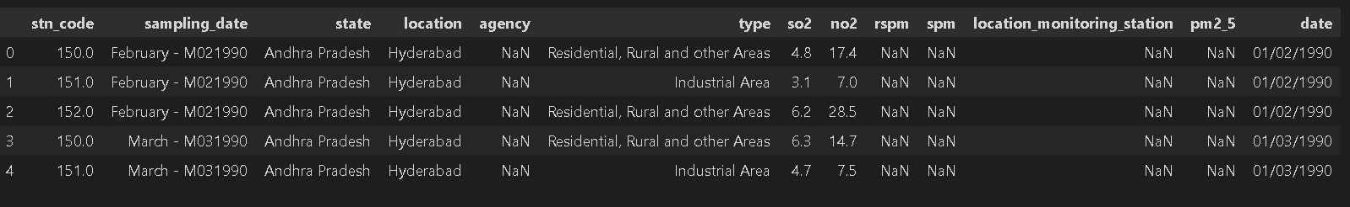
Dataset Description
Source: Kaggle dataset
Dimension of the dataset :435742 rows × 13 columns
Contains the data of different states,cities of india with the date at which the sample is collected
The type indicated the area from where the sample is take n.
Contains pollutant as So2, No2, RSPM, SPM, PM 2.5

Slide 6
Visualization
Heatmap of correlation between different pollutants
Box plot of so2 level by type
Bar graph of the no. sample taken from different state
AQI Range counts
AQI Range by state and location
Actaul vs Predicted value

Slide 7
Data preprocessing
Data Loading
Data Exploration
Handling Missing Values
Outlier detection
Removel of outliers
Data Cleaning
Feature Scaling or Normalization
Feature Engineering
Handling Categorical Variables
Splitting Data into Training and Testing Sets

Slide 8
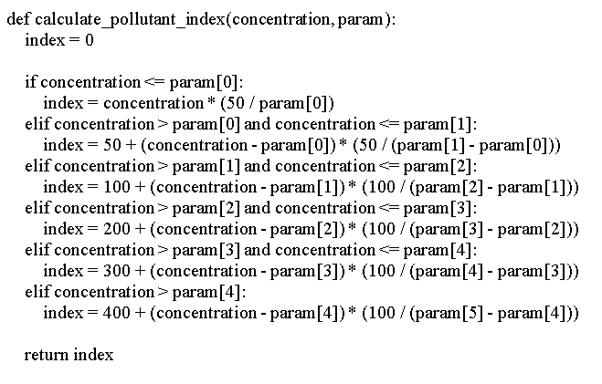
AQI calculation and AQI_Bucket Labels

Slide 9
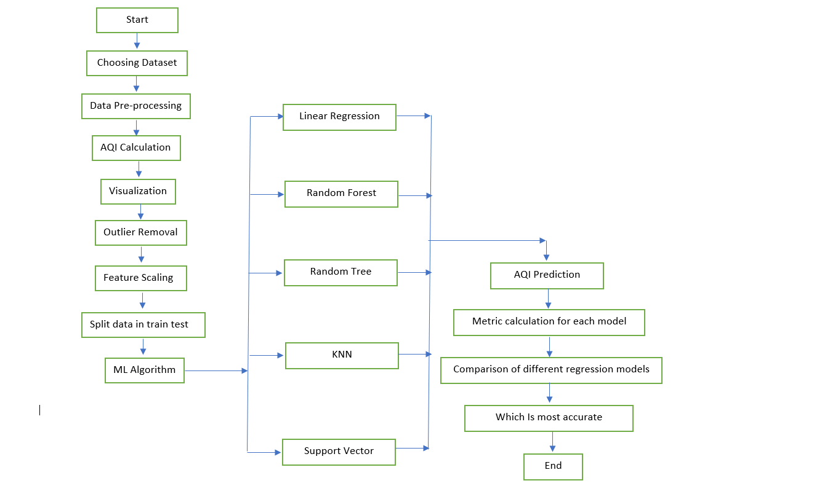
Flowchart of the work

Slide 10
Metrics used for the Regression Model
1. R-Square :R-squared values range from 0 to 1, where 0 indicates that the model does not explain any variability, and 1 indicates perfect prediction. Higher values imply a better fit of the model to the data.
2. Mean Squared Error (MSE): A lower MSE value indicates a closer fit to the data points. A perfect model has MSE equal to zero.
Root Mean Squared Error (RMSE):Like MSE, RMSE is a measure of the model's accuracy, and it is in the same unit as the dependent variable. Lower RMSE values indicate better model performance.
Mean Absolute Error (MAE):It provides a measure of the average absolute errors between observed and predicted values. MAE is less sensitive to outliers compared to MSE, providing a more balanced measure of the model's performance.

Slide 11
Machine Learning Algorithm
1.Linear Regression
2. Decision Tree Regression
3. Random Forest Regression
4. Support Vector Regression
5. KNN Regression

Slide 12
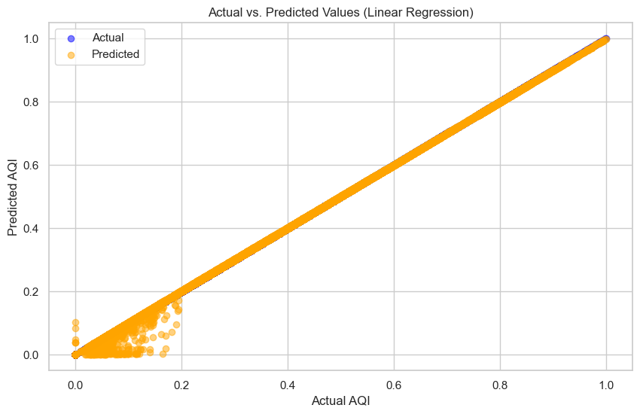
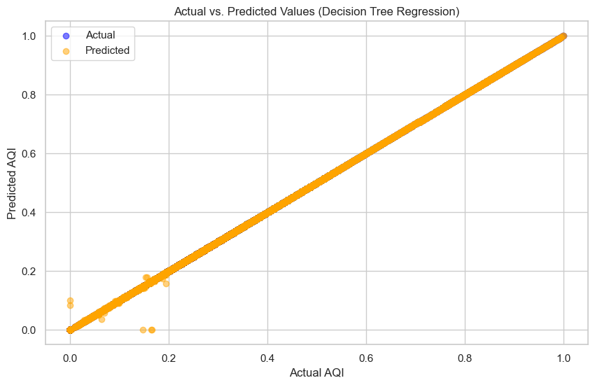
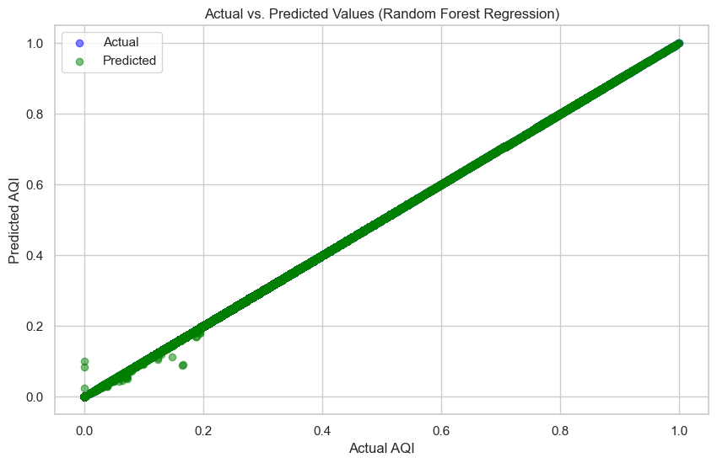
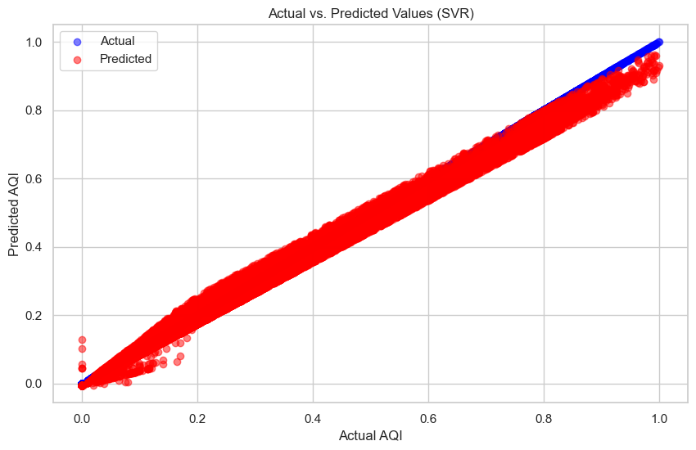
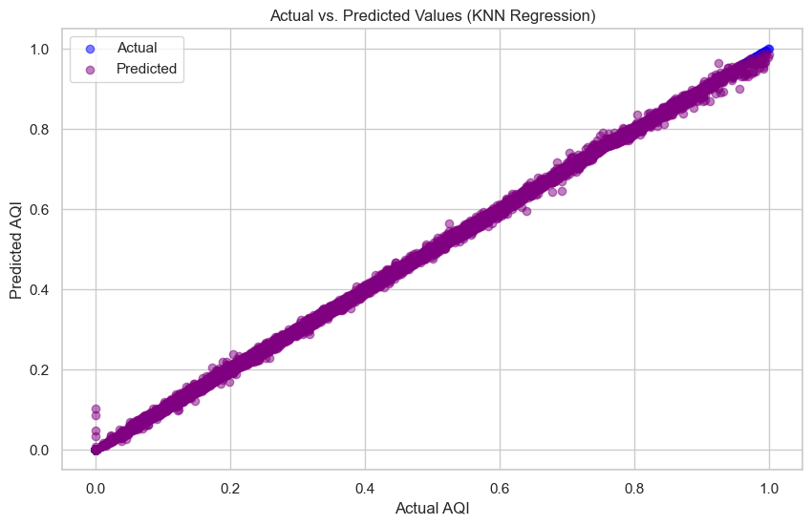
Actual and Predicted Value of Different Models
.
Linear Regression
Decision Tree Regression
Random forest Regression
Support Vector Regression
KNN Regression

Slide 13
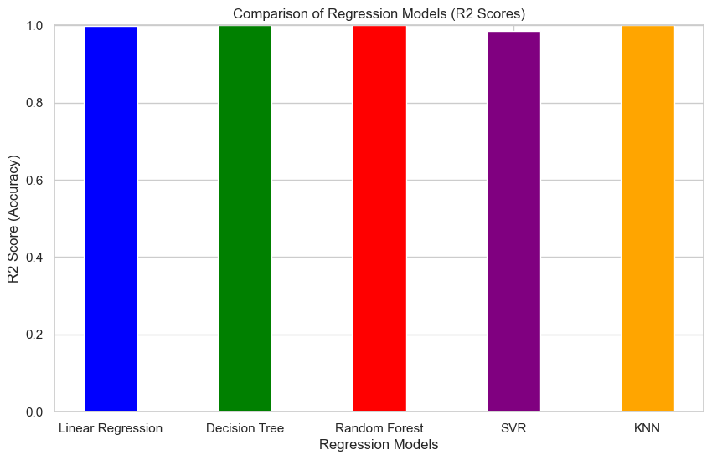
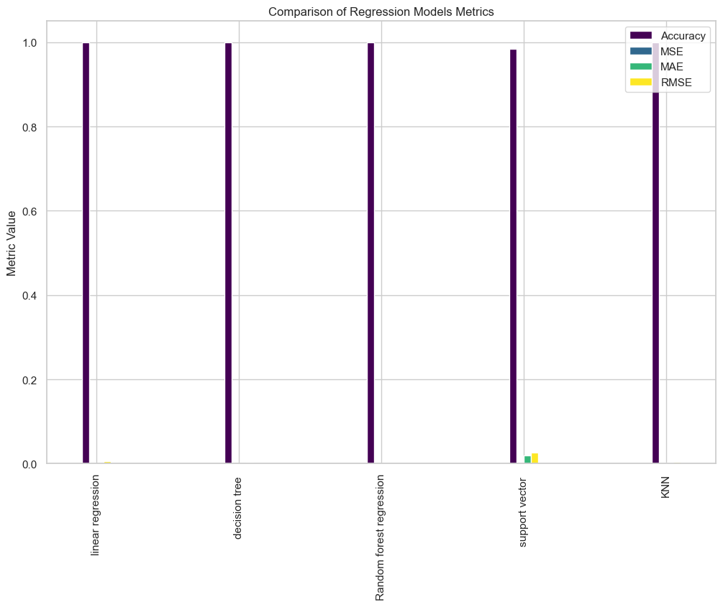
Results:The accuracy and other metrics of ML model
R2 - Value
Metrics comparison

Slide 14
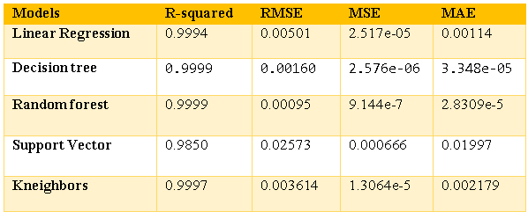
Comparison table
Below is the table for the comparison of the result of the different algorithm that we have used for the model prediction. We can see that every model had performed well and had got the good accuracy above 98%. The other performance metrics also shows that the medel performace is best . The best among the give model is Random Forest Regression model which shows the R2 value of 99.99% and and other value like RMSE , MSE and MAE is very low nearly close to 0.

Slide 15
Conclusion
In conclusion, our study represents a significant step in the domain of Indian air quality analysis and prediction using machine learning. By focusing on pollutants such as NO2, SO2, SPM, and RSPM, and utilizing the Air Quality Index (AQI) as a standardized measure, we have successfully developed a predictive model capable of estimating air Quality. The implemented machine learning algorithms, including Linear Regression, Decision Tree Regression, Support Vector Regression, K-Nearest Neighbors Regression, and Random Forest Regression, have demonstrated exceptional accuracy, with the Random Forest Regression emerging as the most effective model.
Our research contributes to the understanding and mitigation of air quality issues in India by providing a reliable tool for forecasting AQI values. The models' accuracy, exceeding 98%, signifies their potential for real-time implementation in air quality monitoring systems. This has implications for public health, as accurate air quality forecasts empower individuals and organizations to take necessary precautions against harmful pollutants.

Slide 16
Future Work
Incorporation of Additional Data Sources such as meteorological data and real-time sensor reading with additional pollutant
Advanced Machine Learning Techniques deep learning models
Further research can include figuring out if there are specific patterns or trends in how the air quality goes up or down at different times and in different areas.

Slide 17
References for the Literature Survey
1. Gnana Soundari, A., Gnana Jeslin, J., & Akshaya, A. C. (2019). Indian air quality prediction and analysis using machine learning. *International Journal of Applied Engineering Research, 14*(11) (Special Issue), ISSN 0973-4562.
2. B. D. Parameshachari, G. M. Siddesh, V. Sridhar, M. Latha, K. N. A. Sattar and G. Manjula., "Prediction and Analysis of Air Quality Index using Machine Learning Algorithms," 2022 IEEE International Conference on Data Science and Information System (ICDSIS), Hassan, India, 2022, pp. 1-5, doi: 10.1109/ICDSIS55133.2022.9915802.
3. A. Akanksha, N. Maurya, M. Jain and S. Arya, "Prediction And Analysis of Air Pollution Using Machine Learning Algorithms," 2023 3rd International Conference on Intelligent Technologies (CONIT), Hubli, India, 2023, pp. 1-6, doi: 10.1109/CONIT59222.2023.10205615.
4. V. Hable-Khandekar and P. Srinath, "Machine Learning Techniques for Air Quality Forecasting and Study on Real-Time Air Quality Monitoring," 2017 International Conference on Computing, Communication, Control and Automation (ICCUBEA), Pune, India, 2017, pp. 1-6, doi: 10.1109/ICCUBEA.2017.8463746.
5. Madan, Tanisha & Sagar, Shrddha & Virmani, Dr. Deepali. (2020). Air Quality Prediction using Machine Learning Algorithms –A Review. 140-145. 10.1109/ICACCCN51052.2020.9362912.
6. K. M. O. V. K. Kekulanadara, B. T. G. S. Kumara and B. Kuhaneswaran, "Machine Learning Approach for Predicting Air Quality Index," 2021 International Conference on Decision Aid Sciences and Application (DASA), Sakheer, Bahrain, 2021, pp. 622-626, doi: 10.1109/DASA53625.2021.9682221.
7. C. Shi, Y. Wang, Y. Wan and S. Wu, "Air Quality Prediction Based on Machine Learning," 2022 International Conference on Machine Learning and Knowledge Engineering (MLKE), Guilin, China, 2022, pp. 1-5, doi: 10.1109/MLKE55170.2022.00008.
8. Kaur, Gaganjot & Gao, Jerry & Chiao, Sen & Lu, Shengqiang & Xie, Gang. (2018). Air Quality Prediction: Big Data and Machine Learning Approaches. International Journal of Environmental Science and Development. 9. 8-16. 10.18178/ijesd.2018.9.1.1066.
9. Kumar, K., Pande, B.P. Air pollution prediction with machine learning: a case study of Indian cities. Int. J. Environ. Sci. Technol. 20, 5333–5348 (2023). https://doi.org/10.1007/s13762-022-04241-5
10. Bekkar, A., Hssina, B., Douzi, S. et al. Air-pollution prediction in smart city, deep learning approach. J Big Data 8, 161 (2021). https://doi.org/10.1186/s40537-021-00548-1
11. Kumar Singh, Rohit and Raghav, Shekhar and Maini, Tarun and Kumar Singh, Murari and Arquam, Md., Air Quality Prediction using Machine Learning (July 14, 2022). Proceedings of the Advancement in Electronics & Communication Engineering 2022, Available at SSRN: https://ssrn.com/abstract=4157651 or http://dx.doi.org/10.2139/ssrn.4157651
12. Nehete, R., & Patil, D. D. (2021). Air quality prediction using machine learning. International Journal of Current Research and Technology (IJCRT), 9(6), ISSN: 2320-2882.

Slide 18

Thank you !!!!!

